Slide 1
Imperialism
When, if ever, is it valid for one nation or culture to intervene in another to impose its values?

Slide 2
Imperialism
Military reasons
Economic reasons
Moral reasons
American ideals
Economic burden
Racist reasons
Arguments In Favor
Arguments Opposed

Slide 3
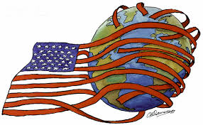

How do you think the idea of manifest destiny set the stage for American imperialism at the end of the century?
Manifest Destiny
U.S. Imperialism

Slide 4
Acquiring Alaska & Hawaii
William Seward
1867-Russia
$7.2 million
1959
Folly?
Sugar Plantations
McKinley Tariff of 1890
Pearl Harbor
1898-territory
1959
Alaska
Hawaii

Slide 5
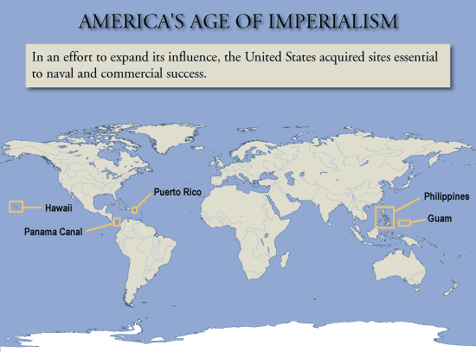

Slide 6
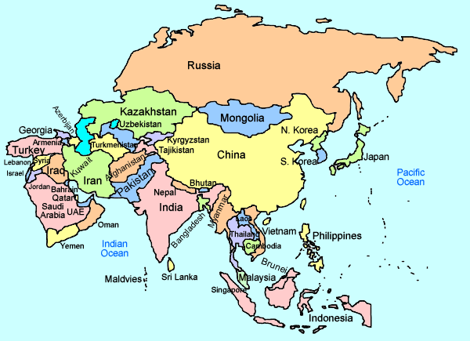
Philippines

Slide 7
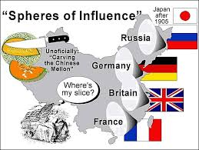
China

Slide 8
U.S. Fears
Secretary of State John Hay
  – Open Door notes (1899)
-imperialist nations will share rights to trade with China-->OPEN DOOR
(no single nation would have a monopoly ontrade with any party of China)
-imperialist nations reluctantly accept this policy

Slide 9
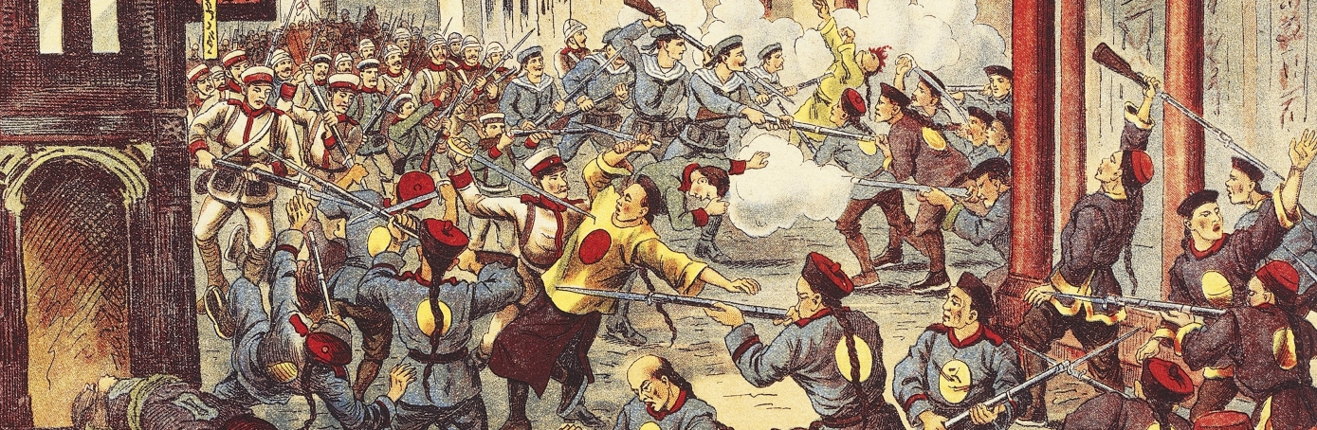
Boxer Rebellion (1900)

