Slide 1
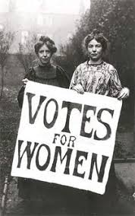
Women in the Progressive Era

Slide 2
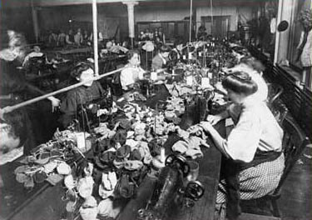
Working Women at the Turn of the Century
Farm women
Domestic workers
Factory workers
White-collar workers

Slide 3
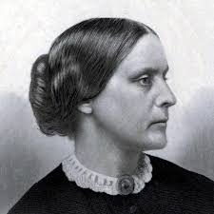
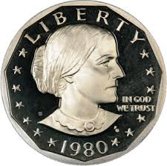
Women’s Suffrage
National American Woman Suffrage Association (NAWSA)
Susan B. Anthony
Three-part strategy

